Slide 1
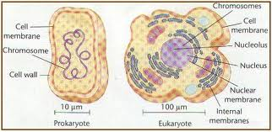
Prokaryote | An organism that does not have a nucleus that is separated by a membrane.
Includes bacteria and archaea They are found in all types of habitats. These organisms are unicellular.

Slide 2
Eukaryote | a living organism made up of cells with true nuclei that divide by mitosis
An organism that uses aerobic (requires oxygen) cellular respiration to break down compounds

Slide 3
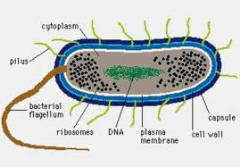
Unicellular | Having only one cell
Prokaryotics, most protists, and some fungi are unicellular. Most of these organisms can only be seen with a microscope. They have a very simple structure

Slide 4
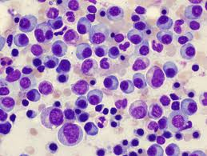
Multicellular | Having many cells
Almost all Eukaryotes are multicellular These organisms are bigger in size and more complex than unicellular organisms. Humans, animals, plants and fungi are all multicellular.

Slide 5
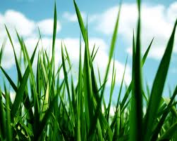
Autotroph | An organism capable of making its own food, using light or chemical energy.
Green plants, algae, and certain bacteria are autotrophs.

Slide 6
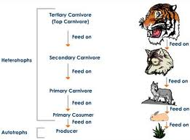
Heterotroph | An organism that cannot make its own food. It eats plants or other animals.
Human beings and most animals are heterotrophs.

Slide 7
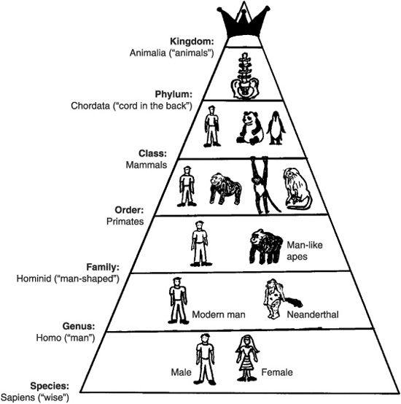
Kingdom | A major category in the classification of animals and plants
The highest taxonomic classification into which organisms are grouped, based on similarities and common ancestry

Slide 8
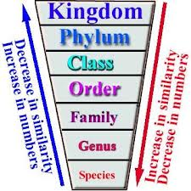
Phylum | A major category in the classification of living organisms, ranking above a class and below a kingdom
Second on the taxonomy scale

Slide 9
Class | A major category in the classification of animals and plants, ranking above an order and below a phylum
Third on the taxonomy scale

Slide 10
Family | A taxonomic category of related organisms ranking below an order and above a genus.
Fourth level on the taxonomy scale

Slide 11
Order | A major category in the classification of animals and plants, ranking above a family and below a class
Fifth level on the taxonomy scale

Slide 12
Genus | A major category in the classification of animals and plants, ranking above a species and below a family
The sixth level on the taxonomy chart

Slide 13
Species | A naturally existing population of similar organisms that breed only among themselves
The seventh and most specific level of the taxonomy chart

Slide 14
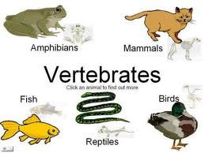
Vertebrate | An animal that has a backbone or spinal column.
Vertebrates include fish, amphibians, reptiles, birds, and mammals.

Slide 15
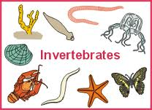
Invertebrate | Having no backbone or spinal column
Corals, insects, worms, jellyfish, starfish, and snails are invertebrates.

Slide 16
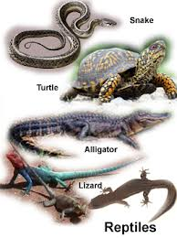
Reptile | Any of various cold-blooded vertebrates of the class Reptilia. They have skin covered with scales or horny plates, they breath air with lungs, and usually having a three-chambered heart. Reptiles reproduce by laying eggs.
Modern reptiles include crocodiles, snakes, turtles, and lizards.

Slide 17
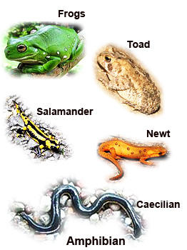
Amphibian | A cold-blooded, smooth-skinned vertebrate of the class Amphibia. They hatch as aquatic larvae with gills for breathing. They then change into four-legged land-based adults with lungs for breathing air. The eggs of amphibians are fertilized by males in the water, rather than inside the mother.
Amphibians include frogs, toads, newts, salamanders, and caecilians.

Slide 18
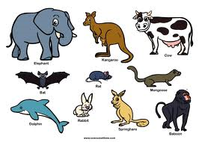
Mammal | Warm-blooded vertebrate animals of the class Mammalia, whose young feed on milk that is produced by the mother's mammary glands.
Mammals include rodents, cats, dogs, ungulates (mammals with hoofs), cetaceans (aquatic mammals like whales and dolphins), and apes.

Slide 19
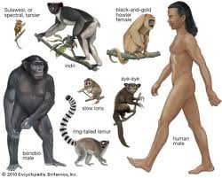
Primate | Primates are distinguished from other animals in that they generally possess limbs capable of performing a variety of functions, hands and feet adapted for grasping (including opposable thumbs), flattened snouts
Primates include monkeys, apes, and human beings

Slide 20
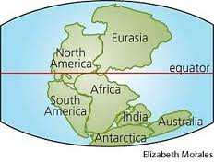
Pangaea | A former “supercontinent” on the Earth.
Pangaea, included all the present continents, which broke up and drifted apart.

Slide 21
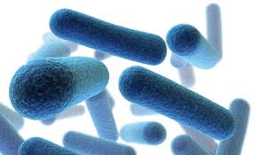
Bacilli | A type of bacteria that is shaped like a rod.

Slide 22
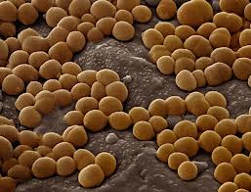
Cocci | A type of bacteria that is shaped like a sphere or ball.

Slide 23
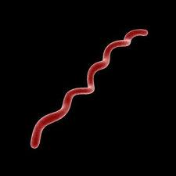
Spirilli | A type of bacteria that is shaped like a spiral.

Slide 24
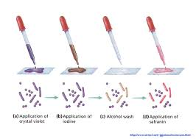
Gram Stain | Gram staining separates bacteria by the properties of their cell walls
A Gram positive result is purple/blue. A Gram negative result is a pink/red color.

Slide 25
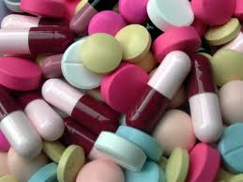
Antibiotic | A substance that is capable of destroying or weakening bacteria or fungi that cause infections or infectious diseases.
Antibiotics do not kill viruses and are not effective in treating viral infections.

Slide 26
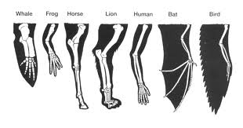
Adaptation | The physical characteristics or behavior of an animal that help it to survive in its environment.
Examples include: -the fins and gills of a fish that help it to swim and breathe in the water -the long neck of the giraffe that allows it to reach leaves in tall trees that are its main source of food..

Slide 27
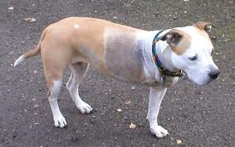
Acquired Trait | A trait that is developed during an organisms lifetime.
These traits are not inherited or passed down from parent to offspring. Acquired traits are things that are learned (you learn to ride a bike) or things that happen (you have an accident and cut off your finger.)

Slide 28
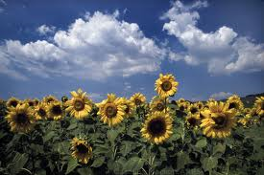
Variation | Individuals in a population are different from each other.
For example, some sunflowers in a filed are taller than others.

Slide 29
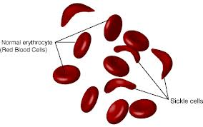
Mutation | A random change in genetic material.
If a mutation help an organism to survive, it may be selected and passed down in future generations. For example, many people in areas with lots of mosquitos inherit a mutation for sickle cell anemic. This mutation helps to protect them from malaria (a disease spread by mosquitos.)

Slide 30
Predator | A person or an animal that hunts a smaller weaker person or animal.
An example of a predator is a lion hunting a gazelle.

Slide 31
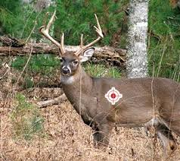
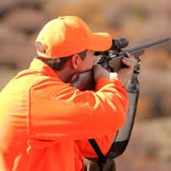
Prey | An animal hunted or killed for food by another animal
An example of prey is a deer being hunted by a man.

Slide 32
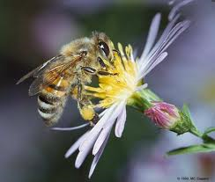
Mutualism | A relationship that benefits two organisms
An example of mutualism is pollination which is when bees take nectar from flowers and then deposit the nectar on another flower.

Slide 33
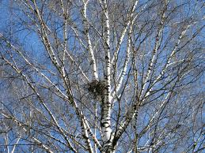
Commensalism | A relationship between two organisms where one is helped and the other is unaffected.
An example of commensalism is when a bird lives in a tree; the bird is helped because it has a place to build its nest and it is high up so protected from predators, but the tree is not affected.

Slide 34
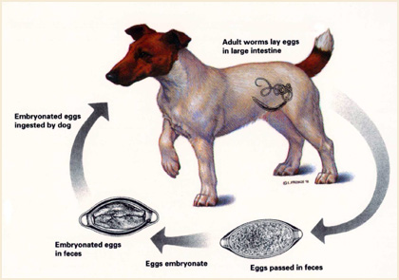
Parasitism | Parasitism is a relationship between two different organisms where the parasite harms the host.
When worms live in a dog and take nutrients from the dog, this is an example of parasitism.

Slide 35
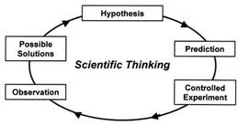
Scientific Theory | A set of statements or principles devised to explain a group of facts or phenomena.
Most theories that are accepted by scientists have been repeatedly tested by experiments and can be used to make predictions about natural happenings.

Slide 36
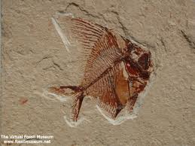
Fossil Record | Fossils are any preserved evidence of an organism. The fossil record is the total number of fossils (discovered and undiscovered.)
Fossils give scientists useful information about adaptations in animals and plants and the environment they lived in.

Slide 37
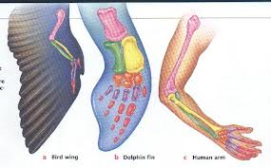
Homologous Structure | Structures that are inherited from a common ancestor, but have different uses.
An example is a human arm and a seal’s flipper.

Slide 38
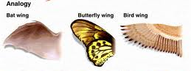
Analogous Structure | Structures that are used for the same purpose, but are not inherited from a common ancestor.
An example is the wings of a butterfly and the wings of a bird.

Slide 39
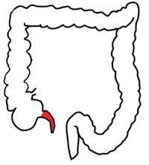
Vestigial Structure | A structure or organ that through the course of evolution has either become smaller or less useful.
Examples are: a human appendix, whale legs or ostrich wings.

Slide 40
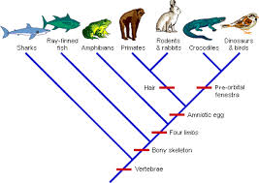
Phylogenic Tree | The lines of descent or evolutionary development of any plant or animal species
The Tree of Life was first shown in Charles Darwin’s book, On the Origin of Species. In this image, Darwin suggested that all of the species developed from one or a few species.

